Slide 1


Slide 2
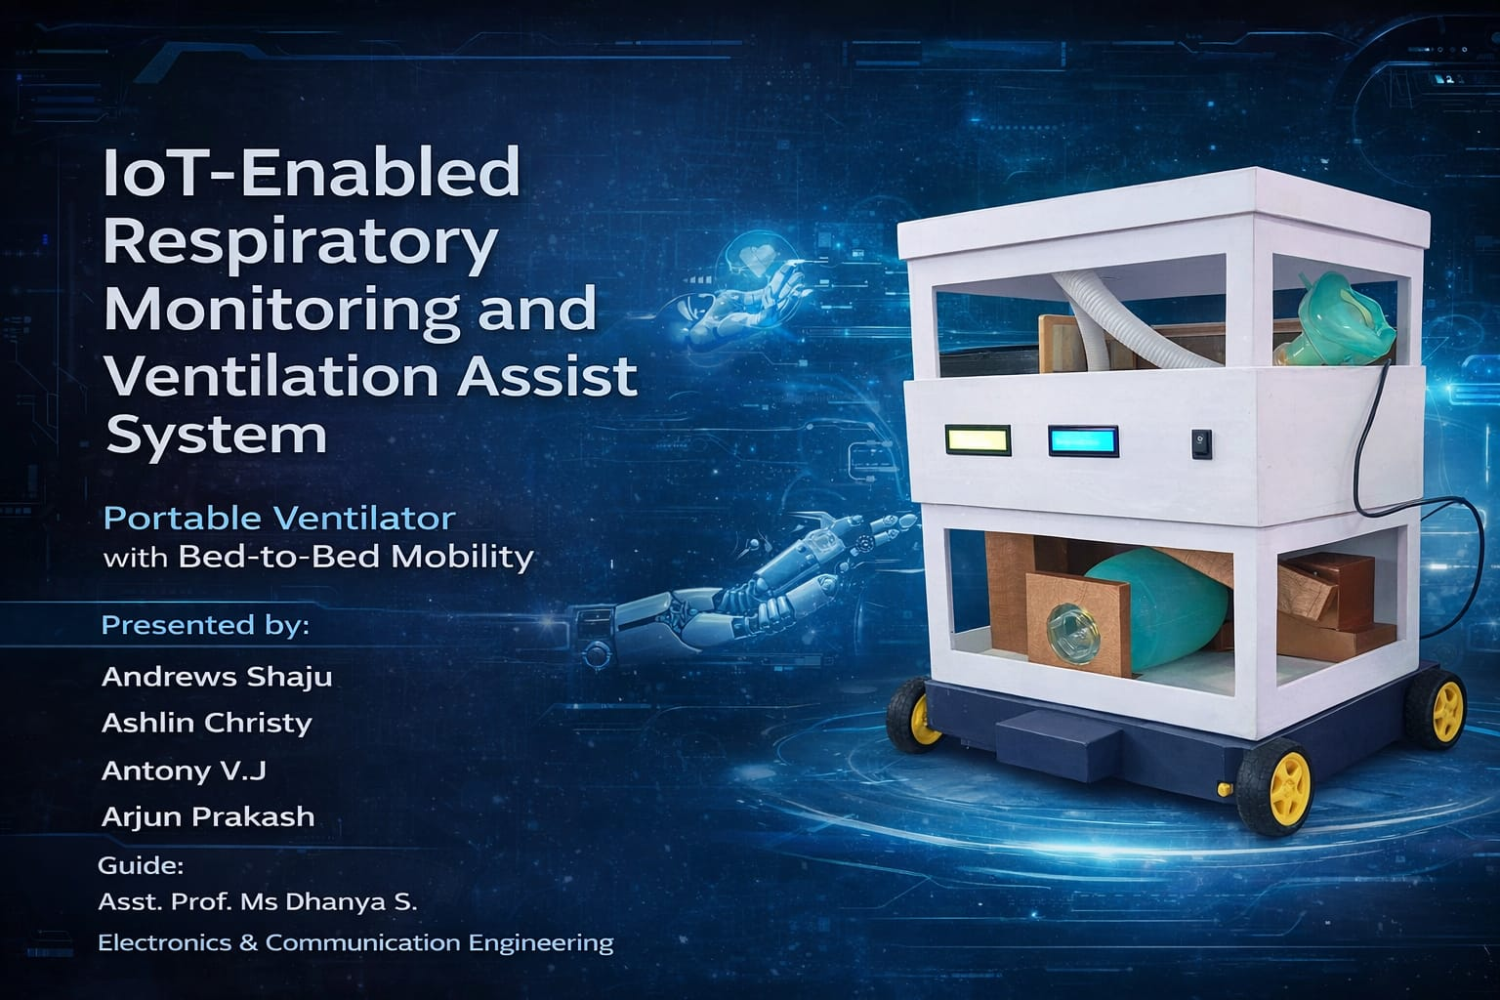
`

Slide 3
Technical Abstract
The IOT-ENABLED RESPIRATORY MONITORING AND VENTILATION ASSIST SYSTEM presents the development of an embedded IoT-based smart ventilator monitoring and control system using the ESP32 microcontroller. The system is designed to acquire, process, and transmit real-time physiological and environmental parameters relevant to assisted ventilation.
The hardware architecture integrates multiple sensors, including the MAX30102 pulse oximeter for measuring SpO₂ and heart rate, and the BMP280 sensor for pressure monitoring. These sensors communicate with the ESP32 via the I2C protocol, enabling efficient data acquisition with minimal wiring complexity. The system also incorporates user input through push buttons and provides real-time feedback using LCD displays interfaced over I2C.
A motor-driven mechanism is employed to simulate the ventilator’s air delivery process, controlled via the ESP32 based on predefined logic and user input. The system supports both manual and remote operation modes. For IoT functionality, the ESP32 utilizes Wi-Fi connectivity to interface with the Blynk platform, enabling real-time data visualization and control through a mobile application.
The software is developed using the Arduino IDE, implementing modular code for sensor interfacing, actuator control, debouncing logic for buttons, and cloud communication. The system demonstrates reliable real-time performance, low power consumption, and scalability for further enhancements such as data logging and automated control algorithms.

Slide 4
Problem Statement
Conventional ventilator systems are expensive and require continuous manual monitoring by healthcare professionals. In resource-limited settings, there is a need for a low-cost, portable, and remotely accessible solution that can assist in monitoring patient respiratory parameters and basic ventilator operation.
This project aims to address these challenges by developing a cost-effective embedded system that can:
Monitor vital parameters like heart rate, SpO₂, and pressure
Provide both local and remote access to data
Allow basic control of ventilator operation
Reduce dependency on continuous physical supervision

Slide 5
Objectives
To design a microcontroller-based ventilator monitoring system using ESP32
To interface biomedical sensors (MAX30102, BMP280) for real-time data acquisition
To implement I2C communication for efficient sensor and display interfacing
To develop a motor control mechanism simulating ventilator airflow
To integrate IoT functionality using Wi-Fi and Blynk for remote monitoring and control
To display real-time data on LCD for local monitoring
To ensure reliable and responsive system performance with proper input handling (debouncing, interrupts if used)
To create a scalable system that can be extended with cloud storage (e.g., Google Sheets)

Slide 6
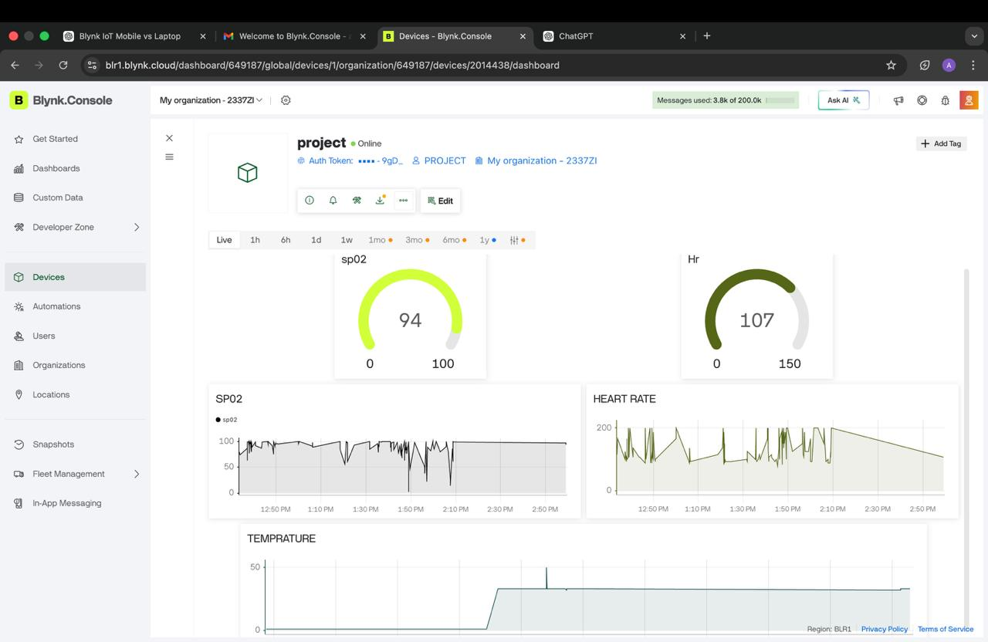

Slide 7


Slide 8
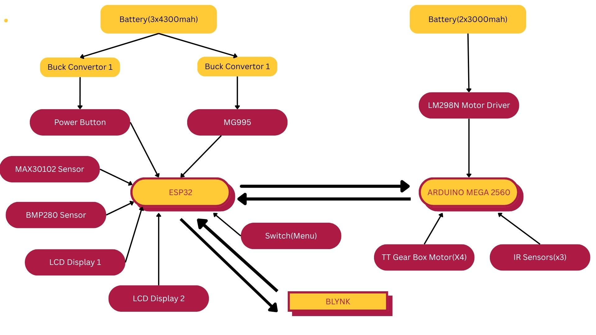

Slide 9
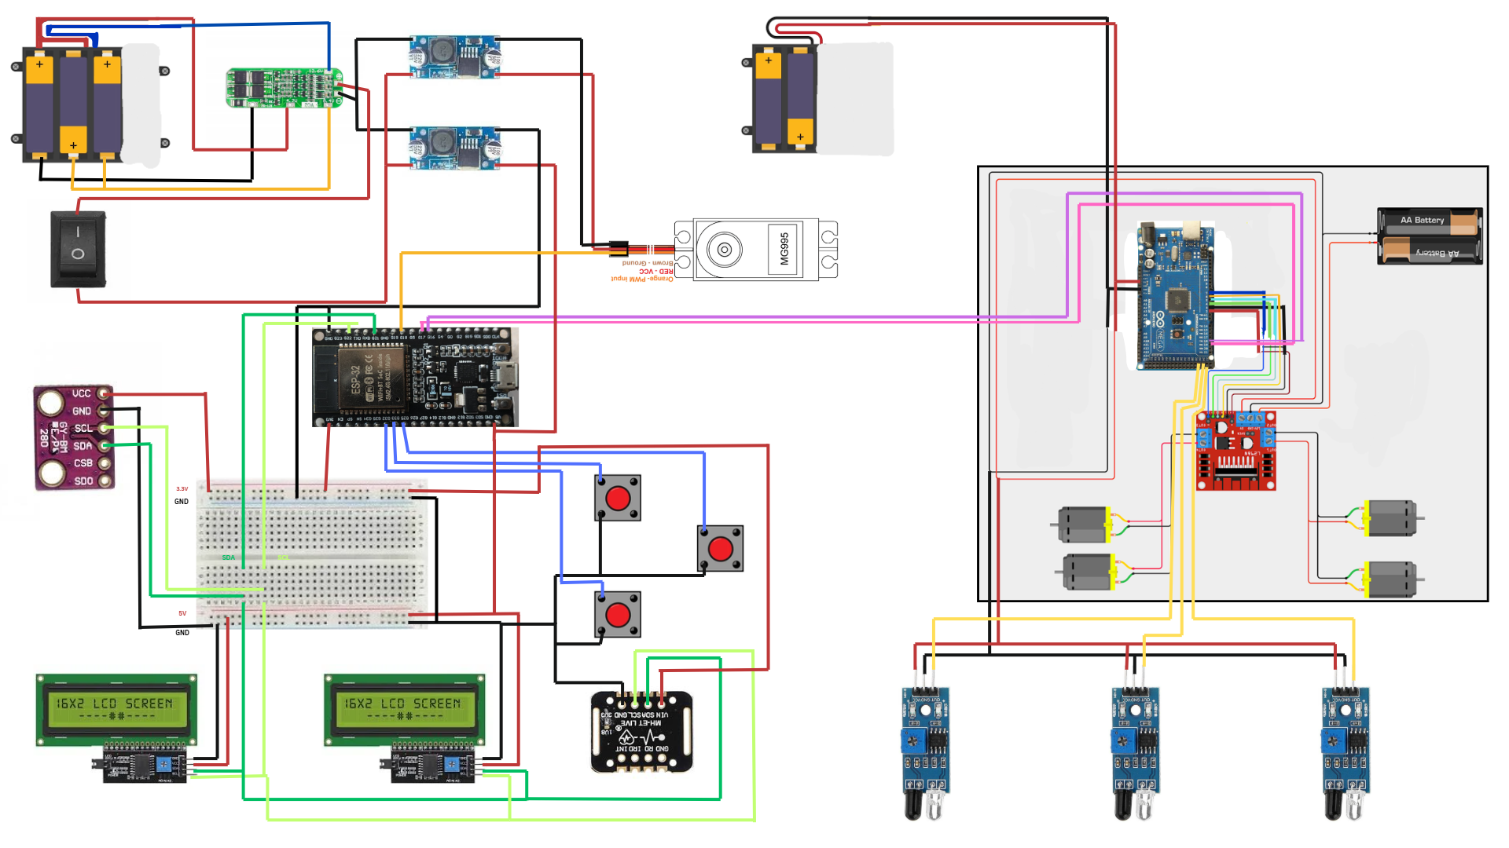

Slide 10
Conclusion
The implemented system successfully demonstrates a low-cost smart ventilator monitoring and control prototype using the ESP32 platform. It effectively integrates sensor data acquisition, actuator control, and IoT-based remote monitoring into a single embedded solution.
The project highlights the potential of combining embedded systems with cloud connectivity to enhance healthcare accessibility and efficiency. Although it is a prototype, the system can be further improved by incorporating advanced control algorithms, alarm systems, and secure cloud data storage, making it more suitable for real-world medical applications.

